Slide 1
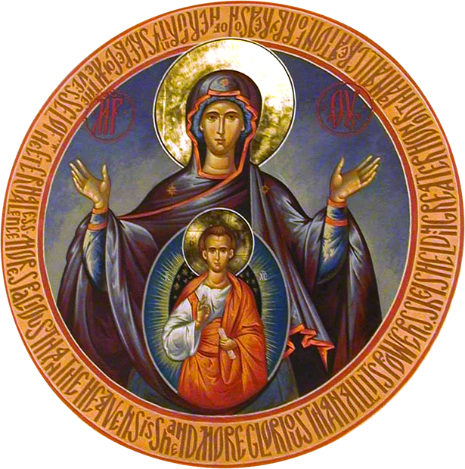
Our Lady of the Sign Holy Wisdom, New Skete
“‘The Hands of a Woman’: Person, Image and Ordination”
It is in the Church's name—in persona Ecclesiae—that the ordained minister, facing East, meaning toward the coming Christ, begs the Father to send the Spirit upon us and upon these gifts here offered, that they may be for us communion in the Body and Blood of Christ "offered up once and for all," as the Epistle to the Hebrews insists. And St John Chrysostom proclaims that "it is Christ, made present by the Holy Spirit, who is the true minister of the mystery." Removing himself as individual, the priest—minister, meaning servant—turns his hands and his tongue over to Christ. Why could these hands and this tongue not be those of a Christian woman, baptized and chrismated, called by virtue of her personal gifts to a ministry of pastoral guidance, which implies presiding over the eucharist?
- Élisabeth Behr-Sigel

Slide 2
Theodore of Studios
Peter is not portrayed insofar as he is animate, rational, mortal, and capable of thought and understanding; for this does not define Peter only, but also Paul and John, and all those of the same species. But insofar as he adds along with the common definition certain properties, such as a long or short nose, curly hair, a good complexion, bright eyes, he is distinguished from the other individuals of the same species (καὶ πάντας τοὺς ὑπὸ τὸ αὐτὸ εἷδος).
- Ref. III.A.34
The seal shows its desire for honor when it makes itself available for impression in many different materials. In the same way, although we believe that Christ’s own image is in Him as He has a human form, nevertheless when we see His image materially depicted in different ways, we praise His greatness more magnificently. For the failure to go forth into a material imprint eliminates His existence in human form.
- Ref. III.D.10

Slide 3
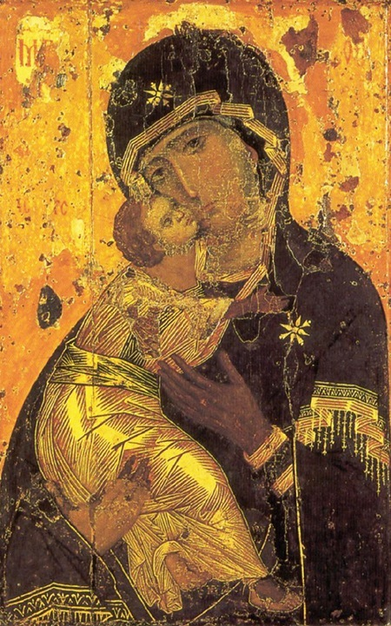
Virgin Eleousa (tenderness, mercy)
Virgin of Vladimir Tretakov Gallery Moscow Early 12th C.

Slide 4
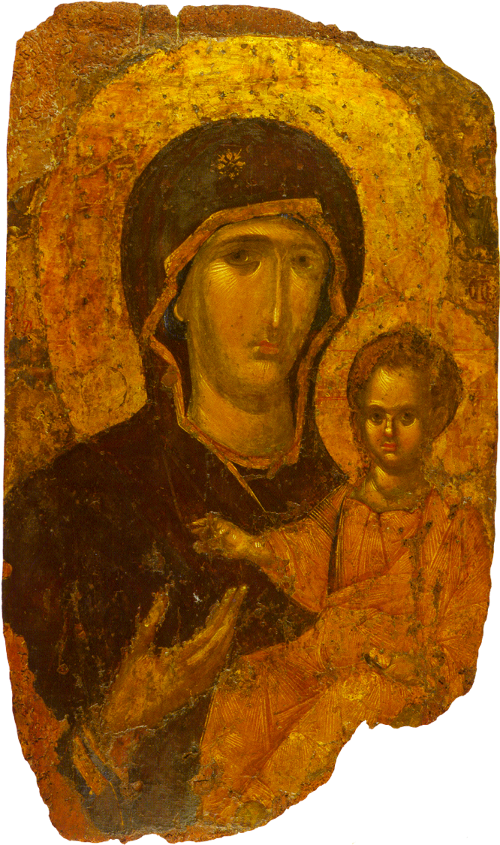
Rhodes, 14th C.
Virgin Hodegetria
She “gave courage to our [soldiers]…. And the Virgin appeared everywhere, winning uncontested victory and inflicting horror and fear on the enemies. She was giving strength to her servants and protecting subjects from harm, on the one hand, and destroying enemies, on the other.
“In the sea battle, the Virgin sank men and boats together before her Blachernai monastery. Consequently the whole bay [i.e., the Golden Horn], if it is not too harsh to say, could be crossed without wetting our feet because of the dead bodies scattered at random…. It was proved most clearly that the Virgin alone fought this battle and won the victory.”
- Theodore Synkellos, 7th century

Slide 5
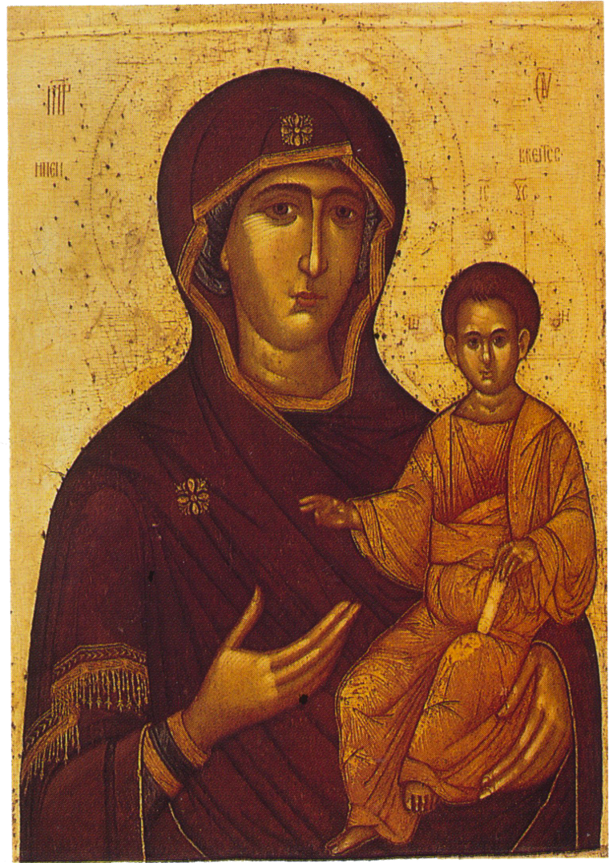
Virgin Hodegetria (Blachernitissa) Byzantine, late 14th C.
“Hail, general of active vigilance!”
If a painter wanted to show the triumph of the battle, he might put forward the One who bore without a seed and only paint her image. For she alone always knows how to conquer nature, first by birth, and then by battle. For as she then gave birth without a seed, in the same way she now gives birth to salvation with no weapons, so that through both deeds she might be found to be a virgin indomitable in the battle as she was in giving birth.”
- George of Pisidia, 7th century

Slide 6
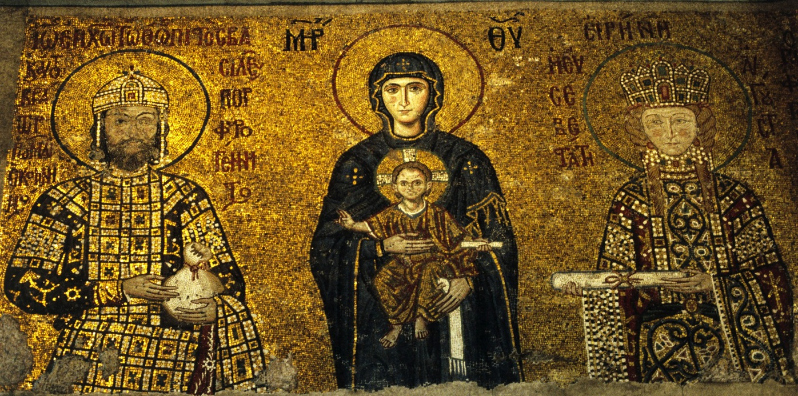
The Theotokos with the Emperor John II Commenus and his Consort Irene
Virgin Enthroned

Slide 7
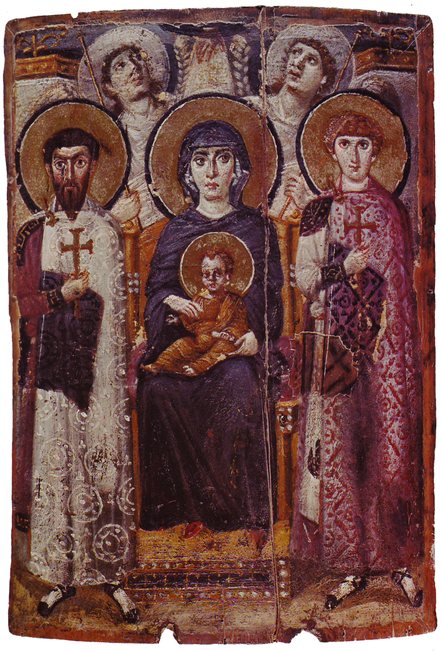
Virgin Enthroned
The Theotokos Enthroned with Soldiers (Sinai)

Slide 8
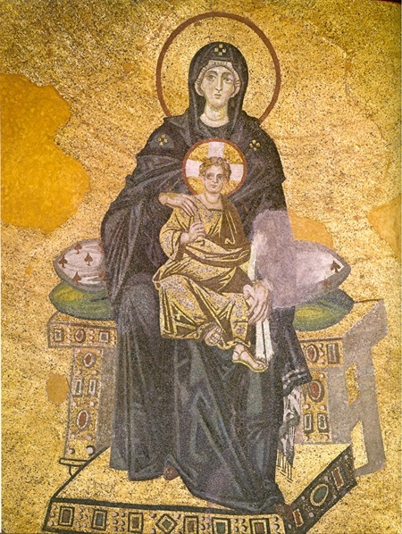
Apse Hagia Sophia 9th c.
“…so that her honor would be unique and not joined with the apostles, but so that she would send them forth and not be sent forth, and so that she would lead the believing people and direct the church in Jerusalem with James the brother of the Lord who was appointed as bishop there….”
“… she was not only an inspiration and a teacher of endurance and ministry to the blessed apostles and the other believers, but she was also a co-minister with the disciples of the Lord, and she helped with the preaching, and she shared mentally in their struggles and torments and imprisonments.”
- Life of the Virgin
Attributed to Maximus the Confessor

Slide 9

Our Lady of the Sign Holy Wisdom, New Skete
Virgin of the Sign
“Therefore the Lord himself will give you a sign. Look, the young woman is with child and shall bear a son, and shall name him Immanuel.”
- Isaiah 7.14

Slide 10
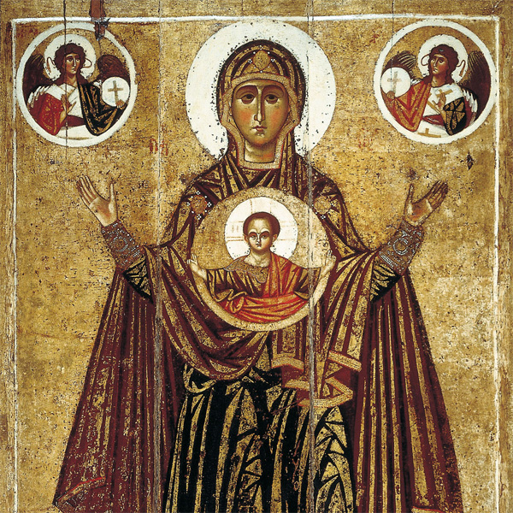
Virgin Orans (Yaroslavl)

Slide 11
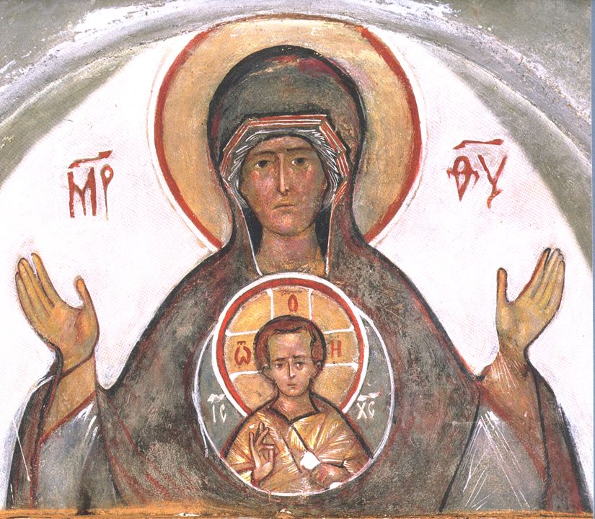
Our Lady of of the Sign (Krug)
Just as we all receive of His fulness, so do we all partake of the immaculate flesh of His all-holy Mother which He assumed, and so, just as Christ our God, true God, became her son; even so we, too—O, the ineffable love for mankind!—become sons of His mother, the Theotokos, and brothers of Christ Himself, as through the all-immaculate and ineffable marriage which took place with and in her….
- Symeon the New Theologian, First Ethical Discourse, X.

Slide 12
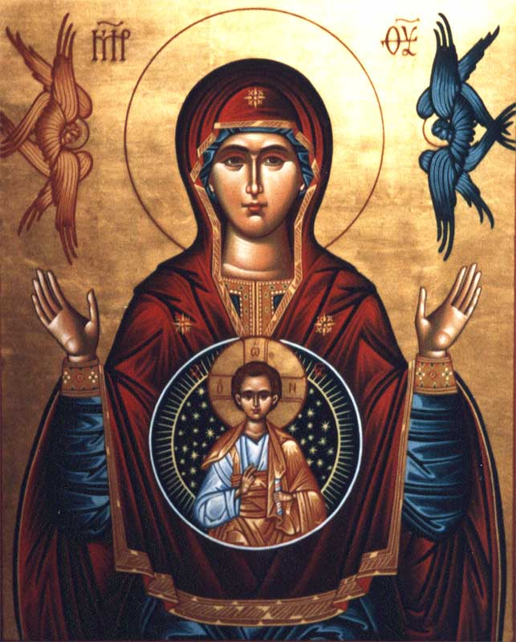
Our Lady of of the Sign (Nun of New Skete)
“…the immortal and incorruptible Word of the immortal and incorruptible God, however, begets and gives birth to immortal and incorruptible children, after having first been born of the virgin by the Holy Spirit.”
- Symeon the New Theologian, First Ethical Discourse, X.
“Blessed is he who has seen the light of the world take form within himself, for he, having Christ as an embryo within, shall be reckoned His mother, as He Himself Who does not lie has promised, saying: ‘Here are my mother and brothers and friends’ [Lk 8:2].”
- Symeon the New Theologian, First Ethical Discourse, X.

